Slide 1

Remote Control Robot
Final Project
Evan Huang
ID620 Embedded Systems

Slide 2
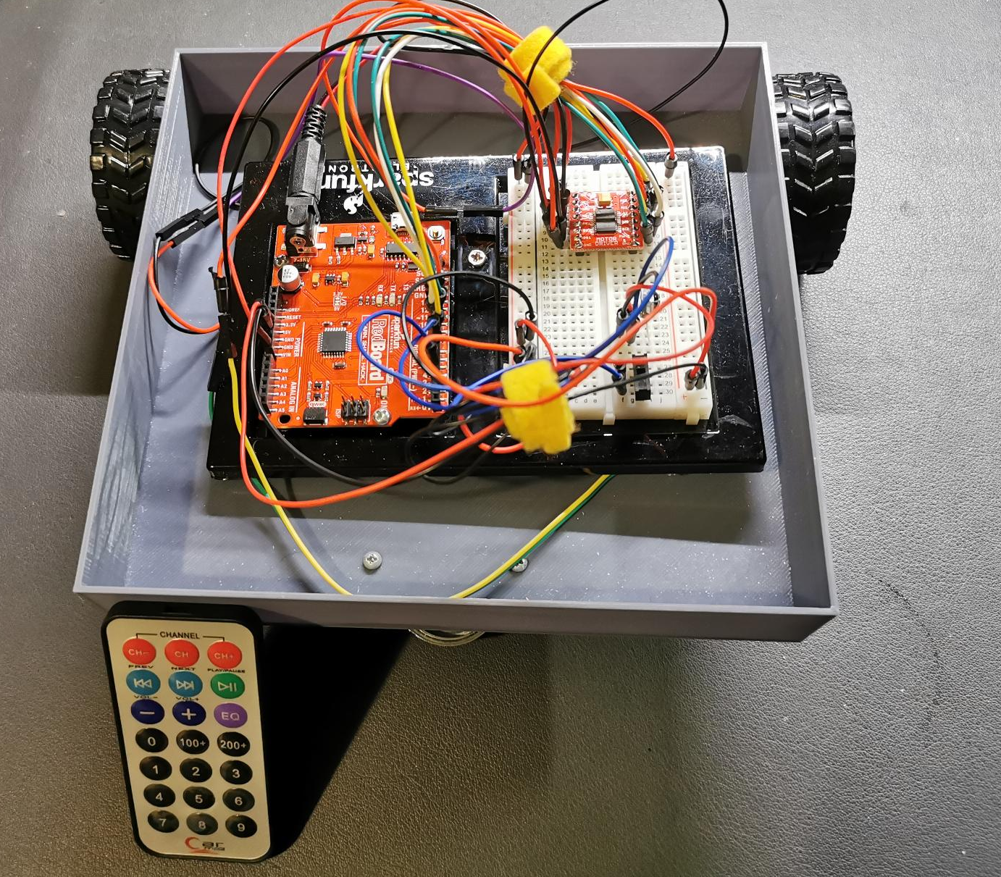
Introduction
This is a remote-control robot is a project based on Arduino that involves building a robot that can be controlled wirelessly using an Arduino IR receiver and remote controller.

Slide 3
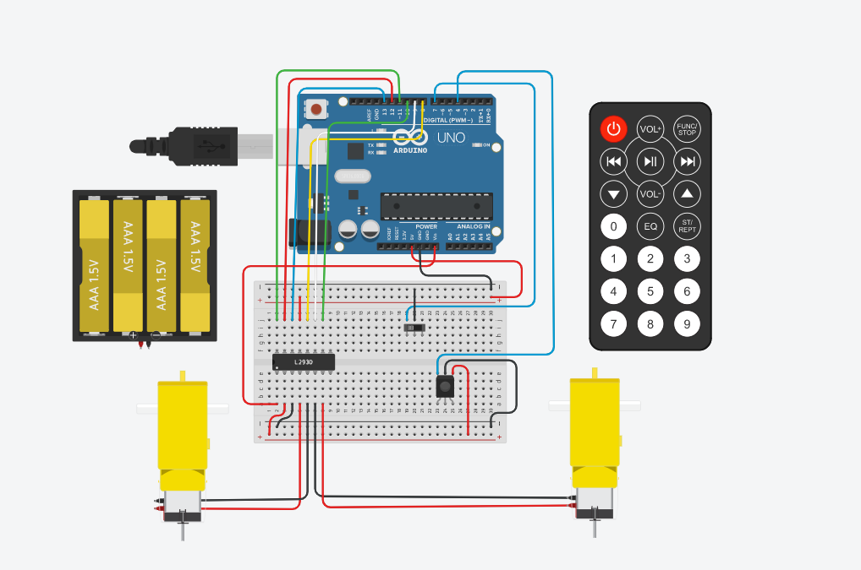

Circuit Diagram
Components:
Arduino Uno
Breadboard
IR receiver & IR remote
2 Gear motors
Motor driver
Jumper wires
Switch
4x AA Batterie

Slide 4
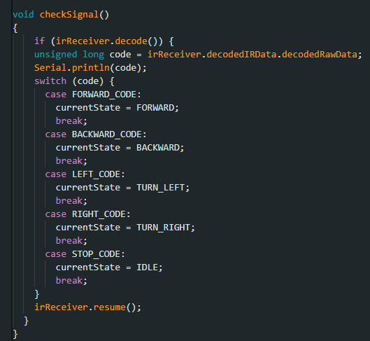

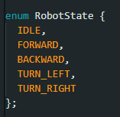
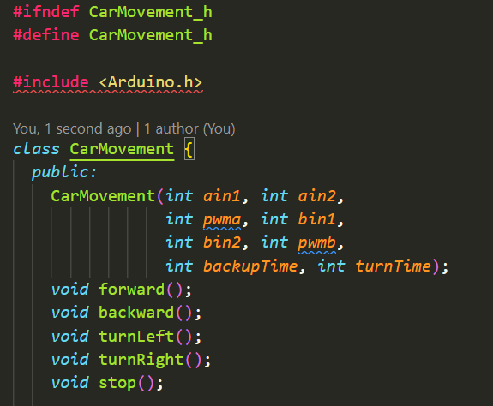
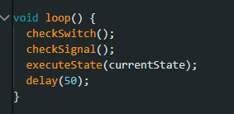
Code
Library
State Machine

Slide 5
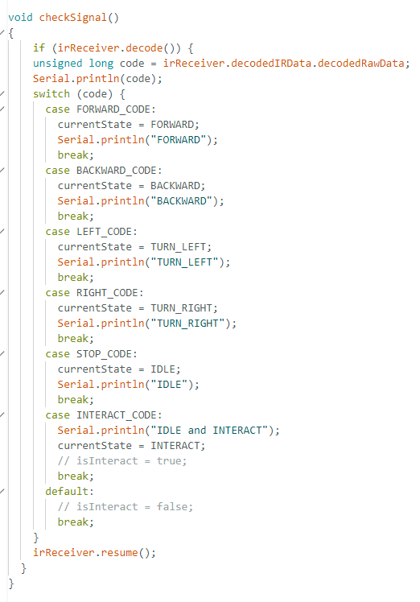
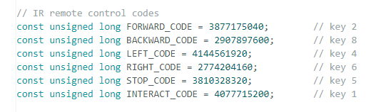
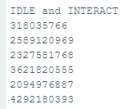
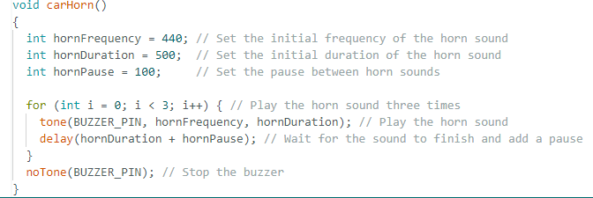
Issues
My potential problems, scope, other issues and how this informed the build of your project

Slide 6
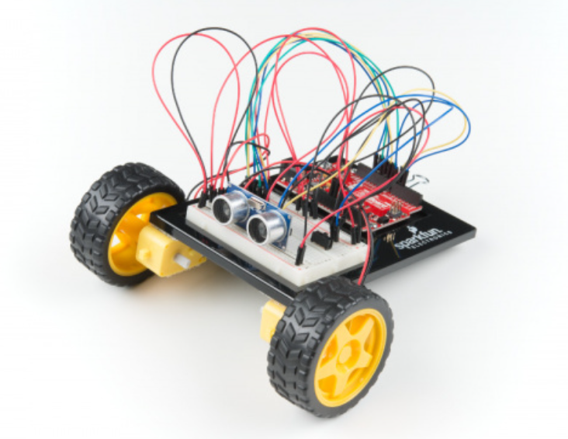
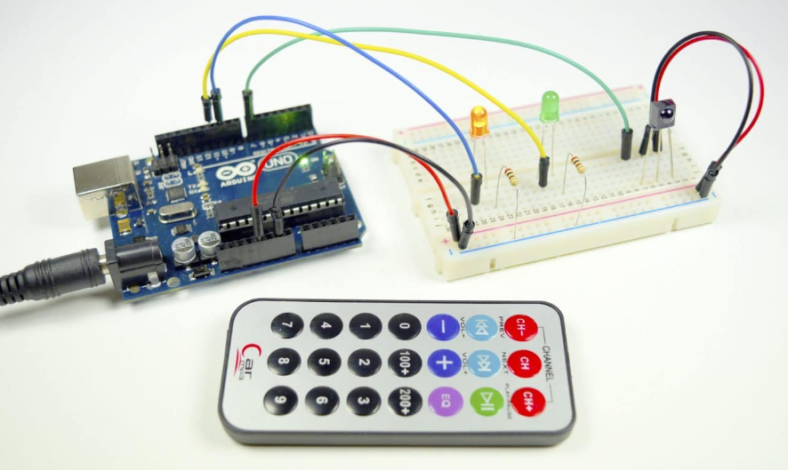
References
SparkFun Inventor's Kit Experiment Guide
https://learn.sparkfun.com/tutorials/sparkfun-inventors-kit-experiment-guide---v41/circuit-5c-autonomous-robot
HOW TO SET UP AN IR REMOTE AND RECEIVER ON AN ARDUINO
https://www.circuitbasics.com/arduino-ir-remote-receiver-tutorial/

Slide 7


Thank You
Presenter: Evan Huang
Email address : haunh8@student.op.ac.nz
GitHub : https://github.com/huanh8/Embedded-System

